Slide 1


Basic Electrical Technology [ELE 1051]
L26 - Electrical Power system components & Transformers

Slide 2
Outline
Power System Components
Generation
Transmission, Distribution
Protection & Control
Types of Loads

Slide 3
Power System Background
Branch of Electrical Sciences dealing with Generation, Transmission & Distribution of electrical energy.
Pearl Street Station in New York City, 1882
“Illuminating Companies” by Thomas A Edison
Concept of DC power generation
Three phase AC power system,1896
2 generators and a transmission line @ 25 Hz.

Slide 4
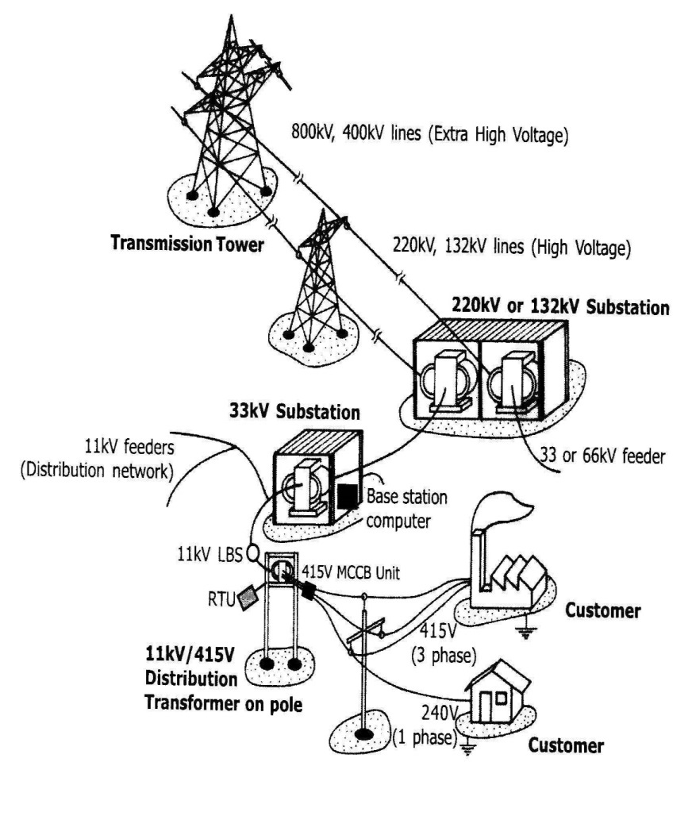
Power System Structure
Courtesy: Olle I Elgerd

Slide 5
Power System Components
Generation subsystem
Transmission subsystem
Sub-transmission subsystem
Distribution subsystem
Protection and Control subsystem

Slide 6
Generation Subsystem
Primary Sources of Energy
Fossil Fuel
Coal, Oil, Natural Gas
Renewable Energy
Water, Solar, Wind, Tidal, Geo-thermal etc.
Nuclear Energy

Slide 7
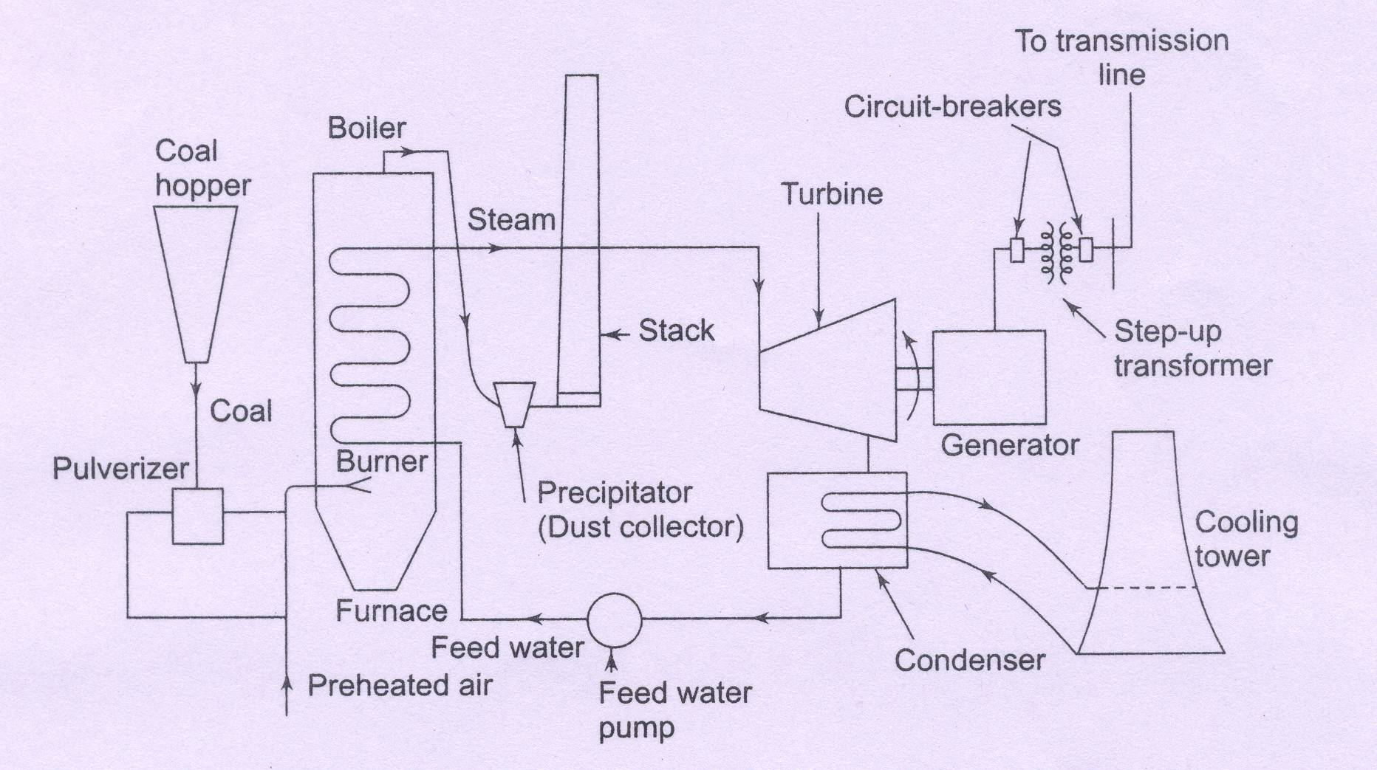
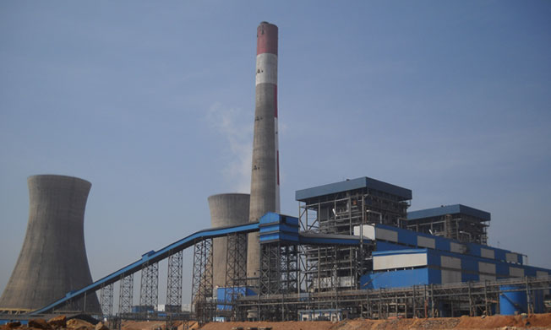
Generation Subsystem
Coal Fired Power plant
UPCL, Padubidri, Mangalore

Slide 8
Generation Subsystem
Thermal Power Stations
Coal Fired
Turbo alternators driven by steam turbine
Oil Fired
Crude oil or Residual oil
Gas Fired
Combined cycle- First stage: Gas turbine, Second stage: Steam Turbine
Diesel Fired
Internal Combustion engines as prime mover
Standby power plants

Slide 9
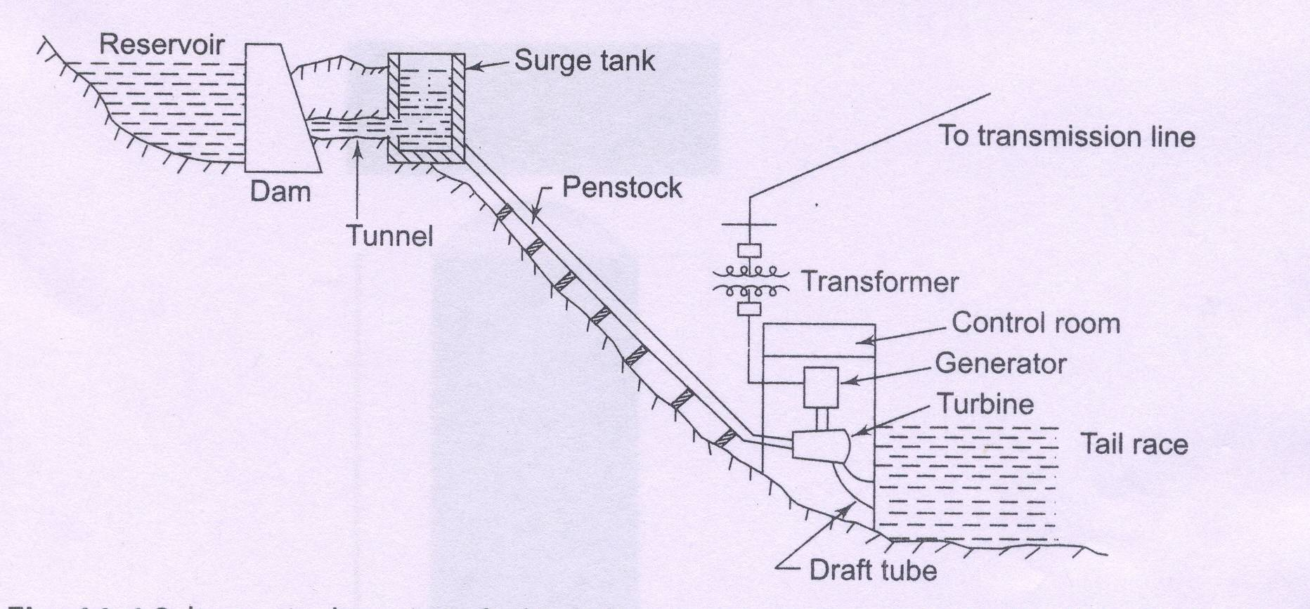
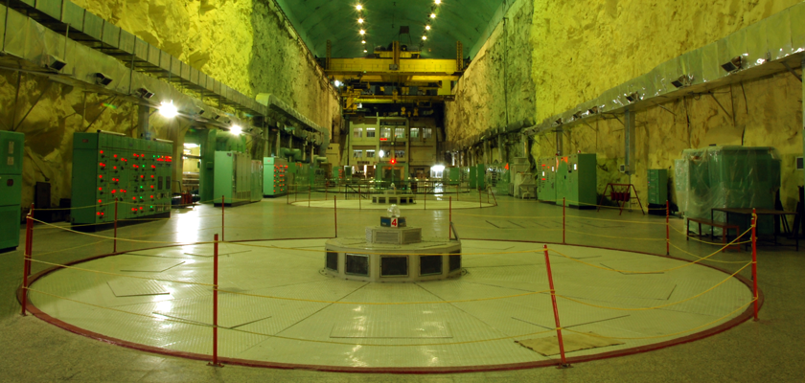
Generation Subsystem
Hydroelectric Power Station
Salient Pole alternators driven by turbines.
Turbines: Impulse Turbine & Reaction Turbine
Pumped storage plants
Varahi Power Plant, Udupi Dist.

Slide 10
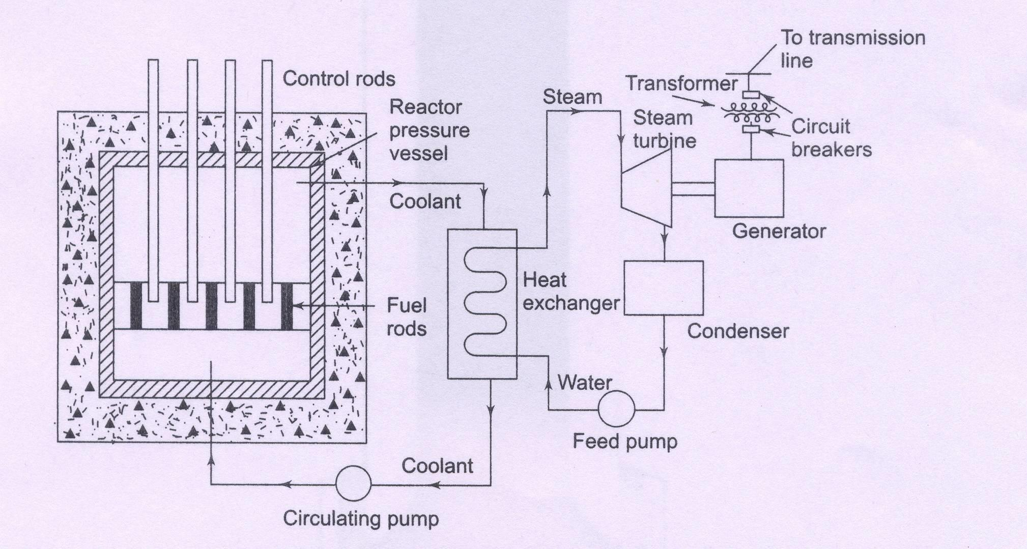

Generation Subsystem
Nuclear Power Plant
Fissile Material
Moderator
D2O, Graphite
Control rods
Boron OR Cadmium
Fast Breeder Reactors
Liquid metal (alloy of Na & K) is coolant

Slide 11
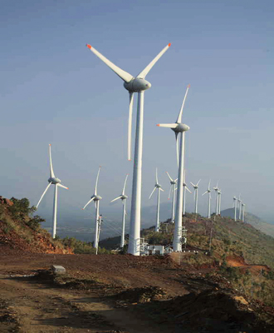
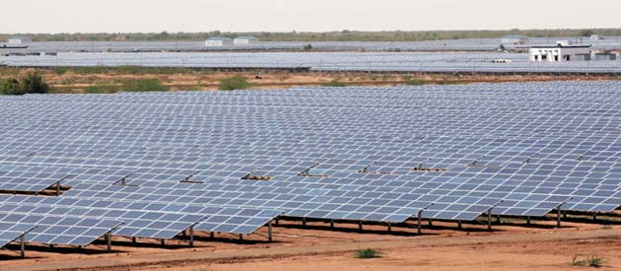
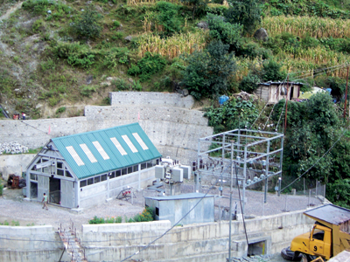
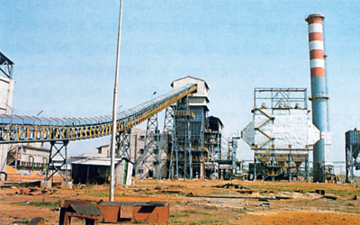
Generation Subsystem
Non-Conventional Power Stations
Wind Power Stations
Solar Power Stations
Micro-Hydel Power Stations
Bio-Mass Power Stations
Geothermal Power Stations
Wind Farm in Karnataka
Solar Park, Charanka Village, Gujarat
1MW hydro plant, HP
Bio-mass Plant, Chattisgarh

Slide 12
Transmission, Sub-transmission & Distribution Subsystems
Transmission networks- EHV AC or HVDC
Operates @765 kV/400 kV/ 220 kV AC or ± 500 kV DC.
AC Sub-Transmission networks
Operates @ 132 kV/ 110kV/ 66 kV/ 33 kV
AC Distribution Network
Primary side: 11 kV
Secondary side: 415 V, 4 Wire

Slide 13

Share of Renewable resources in India
Resource | Potential (MW) | Upto 9th Plan | Upto 10th Plan | 11th Plan Target | Upto 30.09.10 | Cumulative Achievement | 12th Plan Projection (2017) | 13th Plan Projection (2022)
Wind Power | 48,500 | 1,667 | 5,427 | 9,000 | 4,714 | 12,809 | 27,300 | 38,500
Small Hydro Power | 15,000 | 1,438 | 538 | 1,400 | 759 | 2,823 | 5,000 | 6,600
Bio Power | 23,700 | 390 | 795 | 1,780 | 1,079 | 2,505 | 5,100 | 7,300
Solar Power | 20-30 MW/sq km | 2 | 1 | 50 | 8 | 18 | 4,000 | 20,000
Total |  | 3,497 | 6,761 | 12,230 | 6,560 | 18,155 | 41,400 | 72,400
Source: Ministry of New & Renewable Energy, Govt. of India

Slide 14
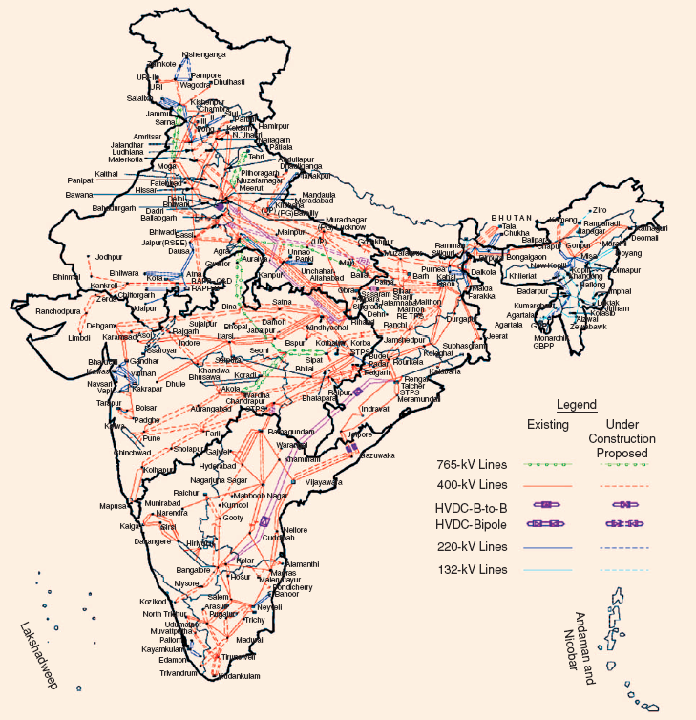
Transmission Network – A Glance

Slide 15
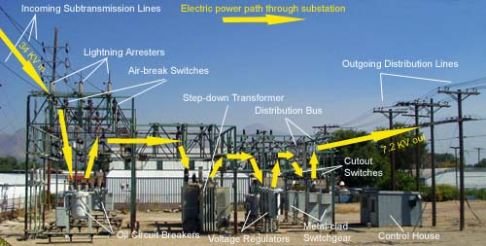
Substation
Substation Components
Lightning Arrester
Carrier line communication equipment (Wave Trap)
Instrument Transformers (CT, PT)
Circuit Breakers
Isolators
Bus Bars
Power Transformers
Control Room

Slide 16
Protection & Control Subsystem
Fail free power is Hypothetical.
Faults: Open Circuit & Short Circuit
Faults detection : Relays.
Fault Isolation: Circuit Breakers
Modern Trend: Supervisory Control And Data Acquisition (SCADA) systems.

Slide 17
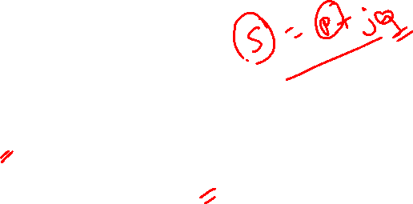
Types of Loads
Industrial Loads
3 Phase
Complex Tariff Structure
Domestic Loads/Commercial Loads
1 Phase
Tariff based on energy consumed- kWH

Slide 18
Domestic Loads and Power Ratings
Incandescent lamps - (5 W to 100 W)
Fluorescent lamps - (20 W & 40 W); CFL - (5 W to 25 W)
LED Lamps-(1W to 100W)
Air Conditioner (1.5 T) - 1800 W
Electric Iron - 750 W
Heaters/ Geysers – 2000 W
Ceiling Fan – 60 W
Washing Machine (with heater) – 2.5 kW
Refrigerator – 160 W
PC – 200 W, Laptop – 40 W
Reduce Electricity bill by minimizing the use of heating / environmental conditioning gadgets

Slide 19
Indian Power Sector – A Glance
Sector | MW | Percentage
State | 1,03617 | 27.7
Central | 93,927 | 25.1
Private | 1,76,655 | 47.2
Total | 3,74,199 | 100.0
As on 17/12/2020
Source: Ministry of Power, Govt. of India

Slide 20
Indian Power Sector - A Glance
Fuel | MW | Percentage
Total Thermal | 2,31,321 | 61.8
Coal | 1,99,595 | 53.3
Lignite | 6,260 | 1.7
Gas | 24,957 | 6.7
Oil | 510 | 0.1
Hydro (Renewable) | 45699 | 12.2
Nuclear | 6,780 | 1.8
RES*(MNRE) | 90,399 | 24.2
Total | 3,74,199 | 100
*RES include small hydro, bio-mass, urban and industrial waste power and wind energy
As on 17/12/2020
Source: Ministry of Power, Govt. of India

Slide 21
Summary
Detailed discussion of various power generating sources.
Different levels of voltages at transmission, sub-transmission and distribution stage.
Types of loads.
Indian Power Sector

Slide 22
Basic Electrical Technology [ELE 1051]
L26 – Transformers

Slide 23

Contents
Introduction
Operation
Representation
Emf Equation
Construction
Core Type
Shell Type
Losses & Efficiency
Auto Transformer
3 Phase Transformer
Applications

Slide 24
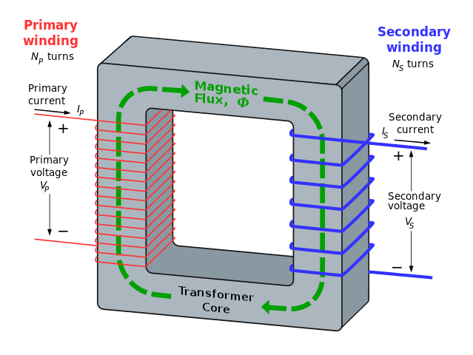
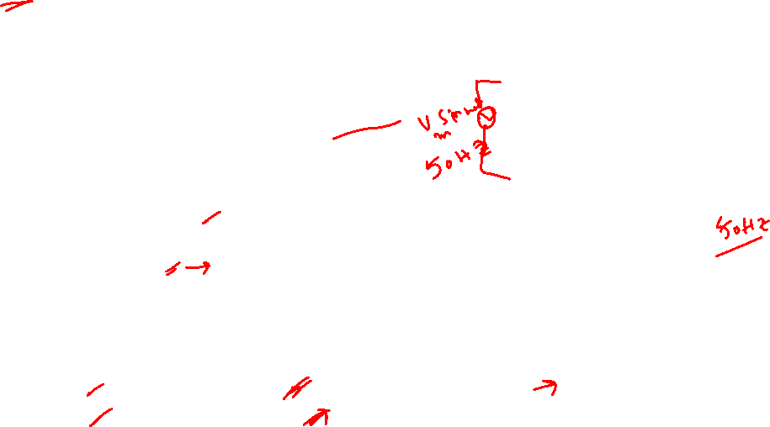
Introduction
Static device with AC excitation
Transfers energy between two or more magnetically coupled circuits without change in frequency.
Principle of operation: Electromagnetic Induction
Electric circuits are linked by a common ferromagnetic core.
Ferromagnetic core ensures maximum magnetic flux linkage
Applications:
Electric power systems.
Power transmission, distribution networks.
Electronic circuits.
Electric traction.
Types
Based on Construction | Based on Function | Based on Windings
Core Type | Step Up | Single Winding
Shell Type | Step Down | 2 or 3 Windings
Notes:
Picture Courtesy: Wikipedia

Slide 27

Operation of Transformer
I₁
I₂
Ø
V₁
E₁
E₂
V₂
LOAD
Magnetic Core : Flux path
Flux Linkages : Primary & Secondary
Induced Emf :
Primary – Self Induced Emf
Secondary – Mutually Induced Emf

Slide 28
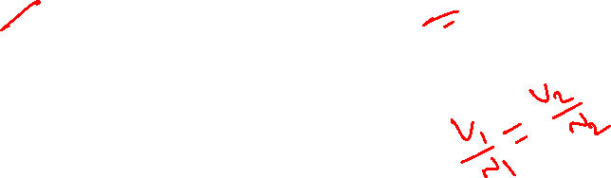
Representation
Core
Supply Side
V₁
N₁
N₂
V₂
Load Side
Primary Side
Secondary Side
N₁ = Number of turns on primary
N₂ = Number of turns on secondary

Slide 30
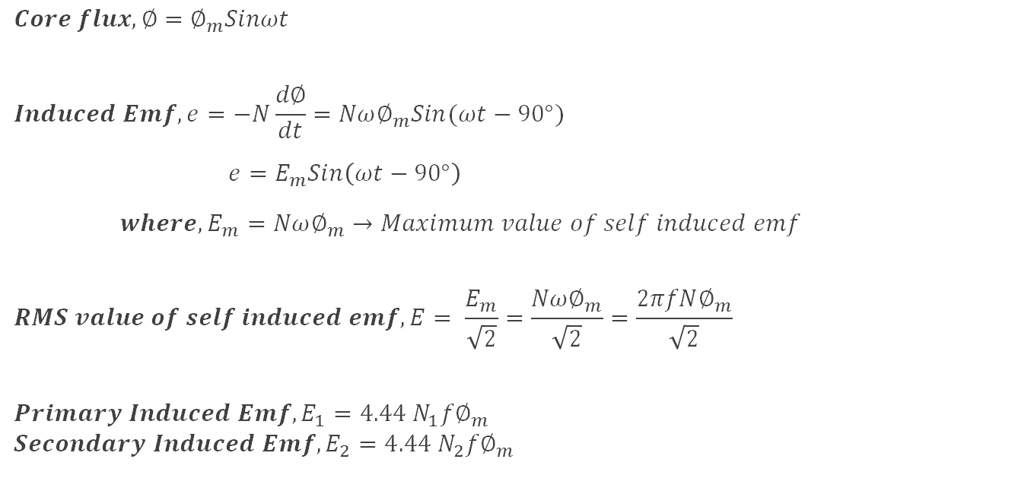
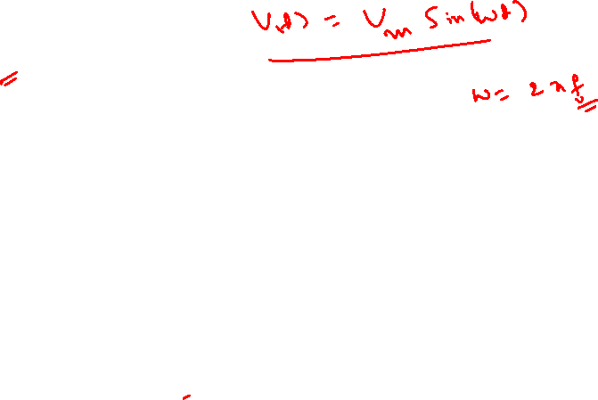
Emf Equation of Transformer
$$Core flux, ∅=∅_{m}Sinωt$$
$$Induced Emf, e=−N\frac{d∅}{dt}=Nω∅_{m}Sin(ωt−90°)$$
$e=E_{m}Sin\left(ωt−90°\right)$
$where, E_{m}=Nω∅_{m}→Maximum value of self induced emf$
$$RMS value of self induced emf, E= \frac{E_{m}}{\sqrt{2}}=\frac{Nω∅_{m}}{\sqrt{2}}=\frac{2πfN∅_{m}}{\sqrt{2}}$$
$$Primary Induced Emf, E_{1}=4.44 N_{1}f∅_{m}$$
$$Secondary Induced Emf, E_{2}=4.44 N_{2}f∅_{m}$$

Slide 31
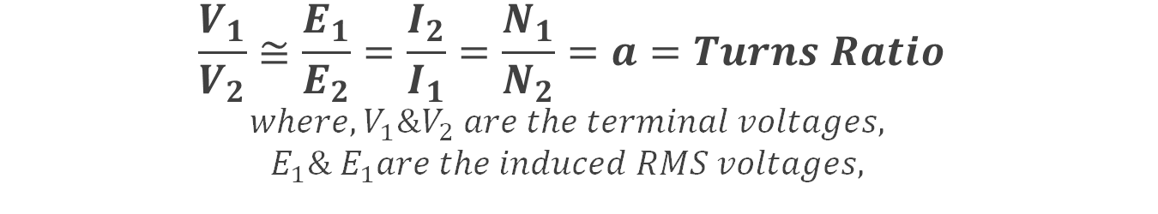
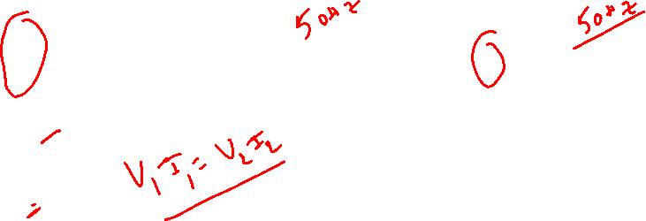
Emf Equation of Ideal Transformer…
$$\frac{V_{1}}{V_{2}}≅\frac{E_{1}}{E_{2}}=\frac{I_{2}}{I_{1}}=\frac{N_{1}}{N_{2}}=a=Turns Ratio$$
$$where, V_{1}\&V_{2} are the terminal voltages,$$
$$E_{1}\& E_{1}are the induced RMS voltages,$$
N₂ > N₁: Step Up
N₂ < N₁: Step down
V₁
V₂
V₁
V₂
N₁
N₂
N₁
N₂
E₂ > E₁
V₂ > V₁ I₁ > I₂
E₂ < E₁
V₂ < V₁
I₁ < I₂

Slide 32

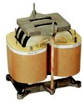
Construction- Core Type
LV winding
Insulation
Limbs
Yoke
Laminations
Core
Winding crossover
Primary &
Secondary windings
Notes:
Picture courtesy: google.com

Slide 33
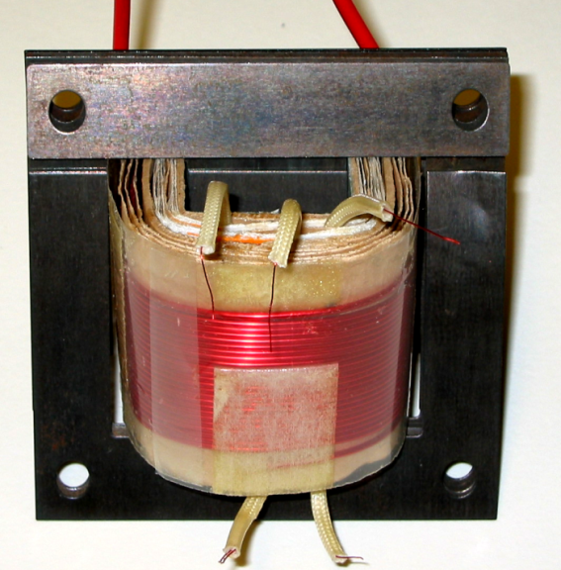
Construction- Shell Type
Yoke
LV winding
Insulation
HV winding
Side Limb
Laminations
Central Limb
Yoke
Core
Insulation
Secondary
Winding
Terminals
Notes:
Picture courtesy: google.com

Slide 34
Losses & Efficiency
Core Loss
Hysteresis Loss
Eddy Current Loss
Depends on flux which is constant hence the loss is constant
Minimized using high graded core material and lamination
Copper Loss
Winding Resistance (in primary and secondary)
Current (or Load) dependent, hence variable loss
Total Loss = Core Loss + Copper Loss
Efficiency: Very high 97% to 99% (since it is a static device)

Slide 36
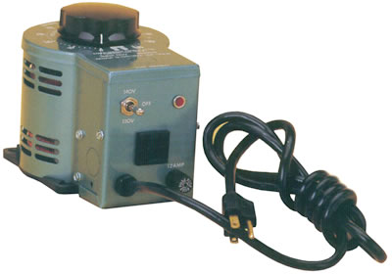
Auto Transformer
One winding transformer
Part of winding common to primary & secondary circuits
One winding wound over the entire core
Secondary winding can be varied using variable point
Used in power applications to interconnect systems operating at different voltage classes, for example 138 kV to 66 kV for transmission
Variable point
Primary winding
N₁ turns
Secondary winding
N₂ turns
Supply side
Load side
Supply side
Load side
Notes:
Picture courtesy: google.com
Picture courtesy: google.com

Slide 37
Auto Transformer- Types
N₁ > N₂ : Step Down type
LOAD
Primary N₁
Secondary N₂
LOAD
N₁ < N₂ : Step Up type

Slide 38
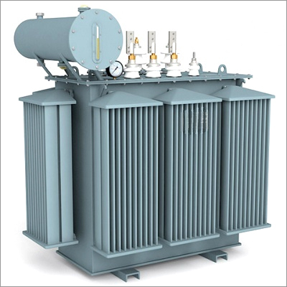
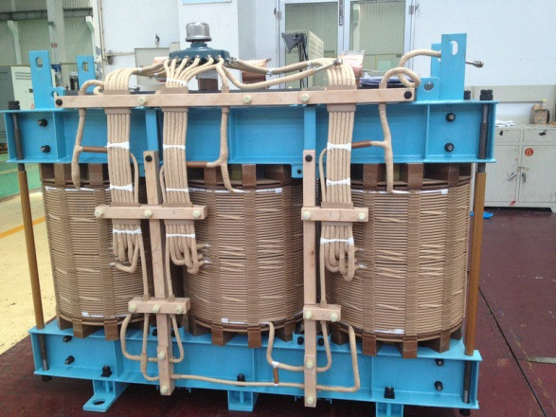
3 Phase Transformer
3 primary coils & 3 secondary coils.
Possible connections of primary & secondary windings:
star/star
star/delta
delta/delta
delta/star
3 single-phase transformers of similar ratings can be connected to form a 3 phase transformer
Notes:
Picture courtesy: google.com

Slide 39
Application
Power Transformer: Used in electric transmission network
Distribution Transformer: Used in electric distribution networks
Instrument Transformers (PT & CT): Used for high voltage & current measurement
Isolation Transformer: 1:1 transformers used in circuits to provide electrical isolation.
Constant Voltage Transformer: Used as voltage regulators
High frequency Transformer: Transformers designed for operating with high frequency – ferrite core

